Slide 1
SALES ANALYSIS
Project Summary Presentation

Slide 2
Introduction The project analyzes a company's sales data to deliver insights into performance, operations, and customer behavior. Dataset includes: Order Date, Customer Info, Product Details, Sales, Profit, Shipping Mode, Region, Discounts, etc. Tools used: Power BI, Excel, Power Query. Methodologies Data Cleaning: Removed duplicates, split customer names, filtered by date (e.g., 2019 orders). Data Modeling: Relationships between tables in Power BI. Visualization: Created KPIs, maps, bar/line/pie charts, scatter plots using Power BI Calculated Measures: Total Sales, Profit, Discounts, Profit Margin, YOY Growth.

Slide 3
Requirement Analysis Divided into 4 main task sets: Task 1: Visuals — sales by customer, region, ship mode, sub-category, trends, and profit relationships. Task 2: DAX calculations — total sales, profit, YOY growth, top customers/products. Task 3: Advanced visuals — cumulative sales, top 5 by profit, average profit, segment-based analysis. Task 4: Power Query — filtering, grouping, tax calculation, cleaning, categorization. Other Parameters (Project Specific) Shipping Mode Efficiency: Identified profitable vs. costly shipping types. Regional Strength: Sales distribution by city and region (e.g., West outperformed others). Product Impact: Top-performing vs. underperforming products. Discount-Driven Sales: Insights on how discounting impacts profitability.

Slide 4
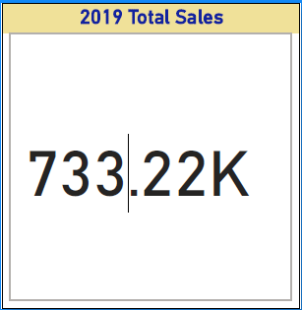
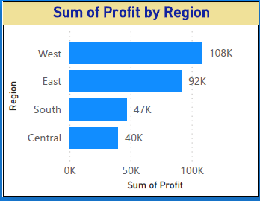
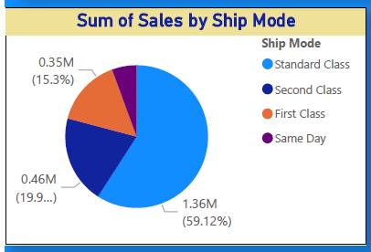
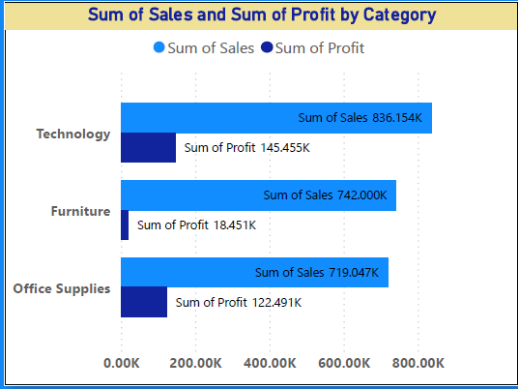
Visualizations (From Dashboard) Total sales by customer Sum of Profit By Region Sum of Sales by Ship Mode: Sum of Sales and Sum of Profit by Category

Slide 5
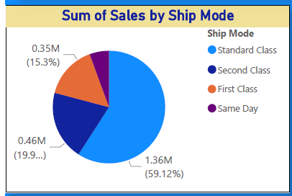
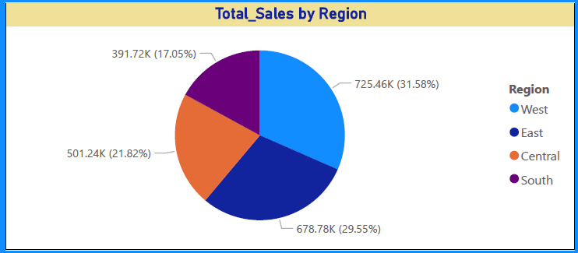
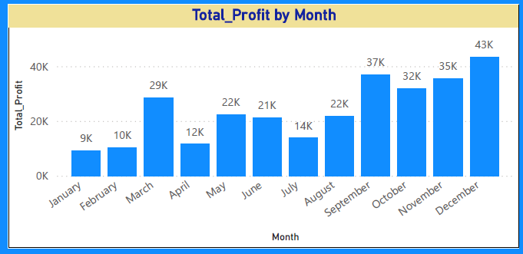
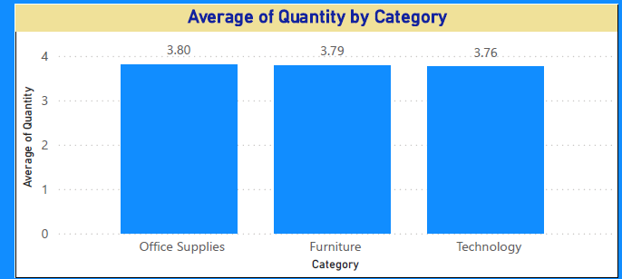
Visualizations (From Dashboard) Sum of Sales By Ship Mode Total Sales by Region Total Profit by Month Average of Quantity by Category

Slide 6
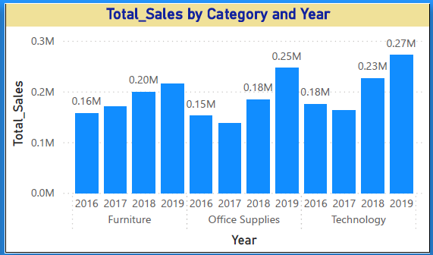
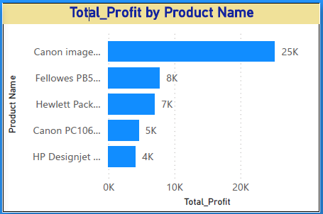
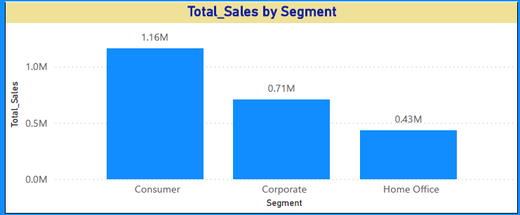
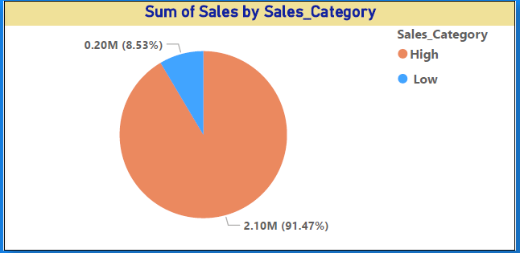
Visualizations (From Dashboard) Total Sales by Category and Year Total Profit by Product Name Total Sales by Segment Sum of Sales by Sales Category

Slide 7
Insights Top Regions: West and East regions lead in profit; Central region has growth potential. Customer Behavior: Few top customers contribute to large sales volumes Products: Technology and Office Supplies dominate profit margins. Shipping: Standard Class yields most orders; First Class contributes higher profit per sale. Discounting: Moderate discounts boost quantity but reduce margins significantly. Sales Tax Addition: Increased tracking of tax liability per category helps in financial planning.

Slide 8
Conclusion Performance: Balanced across product lines, but regional gaps exist. Recommendations: Increase focus on underperforming regions. Reevaluate discount strategies to optimize profitability. Replicate high-value customer behavior patterns. Optimize logistics for better profit margins.

